Slide 1
網路儲存技術: From Backup to Replication
陳秋男

Slide 2
Syllabus
Backup
VTL, Virtual Tape Library
Deduplication
VM Backup
Replication
CDP, Continuous Data Protection

Slide 3
Keywords
Backup server
執行backup/restore的動作
設定週期性的backup動作
設定要backup哪些檔案…
Backup device
儲存備份的資料 (硬碟或磁帶)
Metadata (in the backup server)
紀錄備份動作的相關資訊: log, time, range, type…
Application server / backup client (with agent)
應用伺服器: 需要被分的對象
Storage node
提供資料運算與儲存的空間(硬碟)

Slide 4
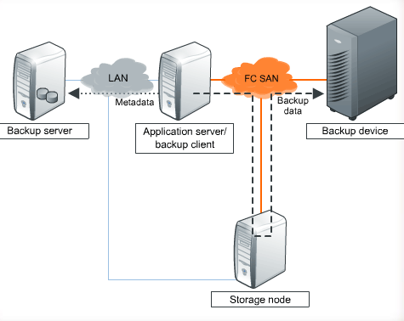
SAN-based Backup

Slide 5
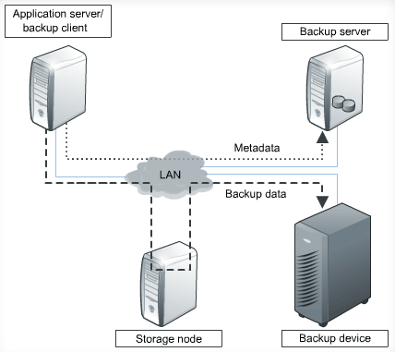
LAN-based Backup

Slide 6
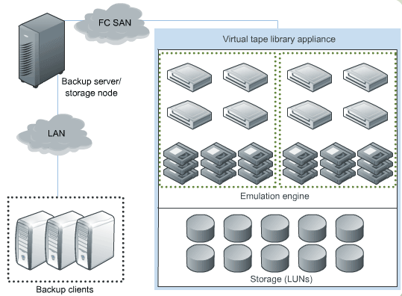
VTL, Virtual Tape Library

Slide 7
Deduplication
File-level deduplication (single-instance repository)
如果檔案的差異不大, 即無法dedupe, 無法節省很多空間.
Sub-file deduplication
Fixed-length block
Variable-length segment
Dedupe Types: source or target-based
Bandwidth, server loading, backup loading…

Slide 8
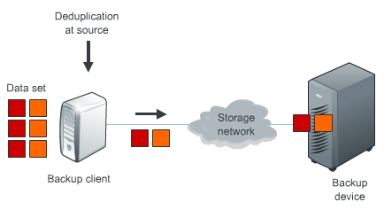
Source-based Dedupe

Slide 9
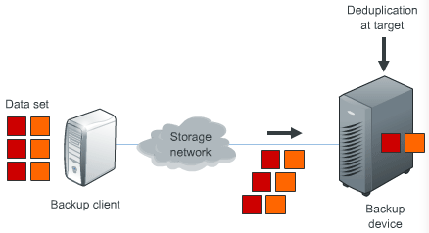
Target-based Dedupe

Slide 10
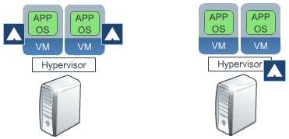
VM Backup
Backup agent runs on each VM.
Backup agent runs on hypervisor.

Slide 11
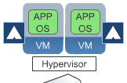
VM Backup, agent runs on each VM
每一部VM都要安裝agent.
就像是在傳統實體機器上的備份環境.
Dedupe VM上的資料
無法備份VM file: BIOS, configuration…

Slide 12
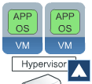
VM Backup, agent runs on hypervisor
Agent只需安裝在hypervisor server上.
不是備份整部 hypervisor server.
對hypervisor而言, VM就只是一堆檔案.
Dedupe可以發揮最大功效, 當VM間的差異不大時.

Slide 13
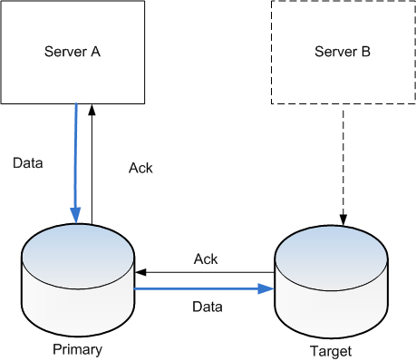
Replication
同步 / 非同步 replication.
Point-in-time (snapshot) replication.

Slide 14
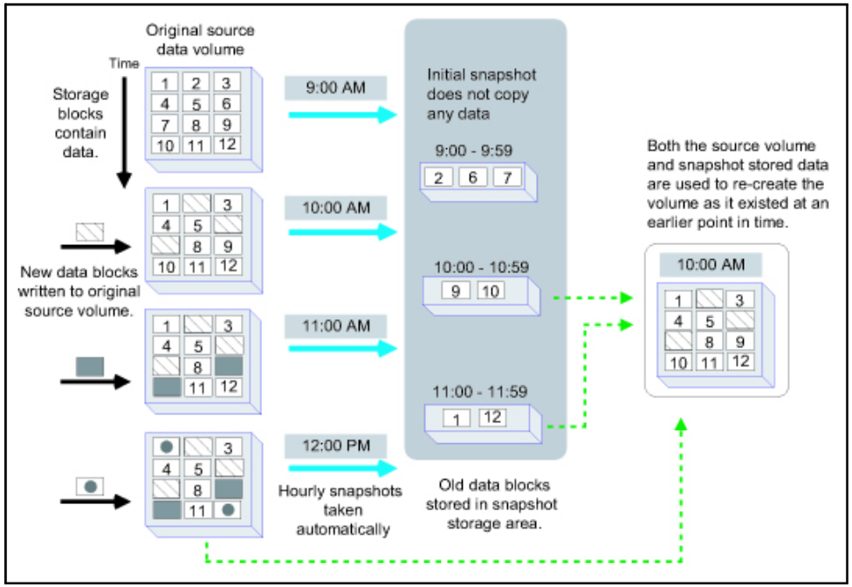
Snapshot and Replication

Slide 15
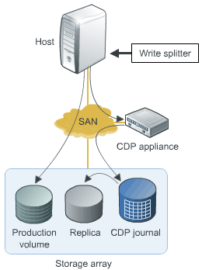
CDP, Continuous Data Protection
Write splitter.
Agent, duplicate data.
CDP appliance.
Manages replication.
CDP Journal.
Data changes.
Local replication.
Sync the production volume and replica.

Slide 16
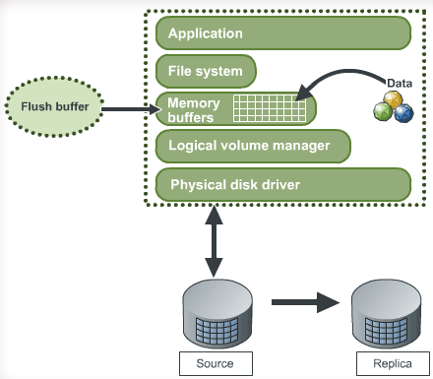
Sync (flush and replication)

